Slide 1
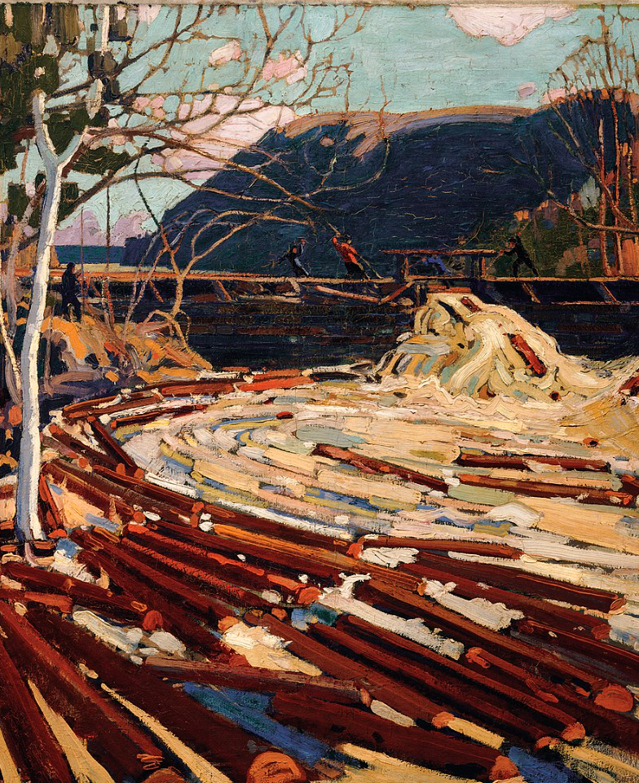

Eco-Labels & Life Cycle Analysis
IL “Sustainability & Environmental Management” SS 25
Kami Höferl
(Thomson, 1916, PD)

Slide 2
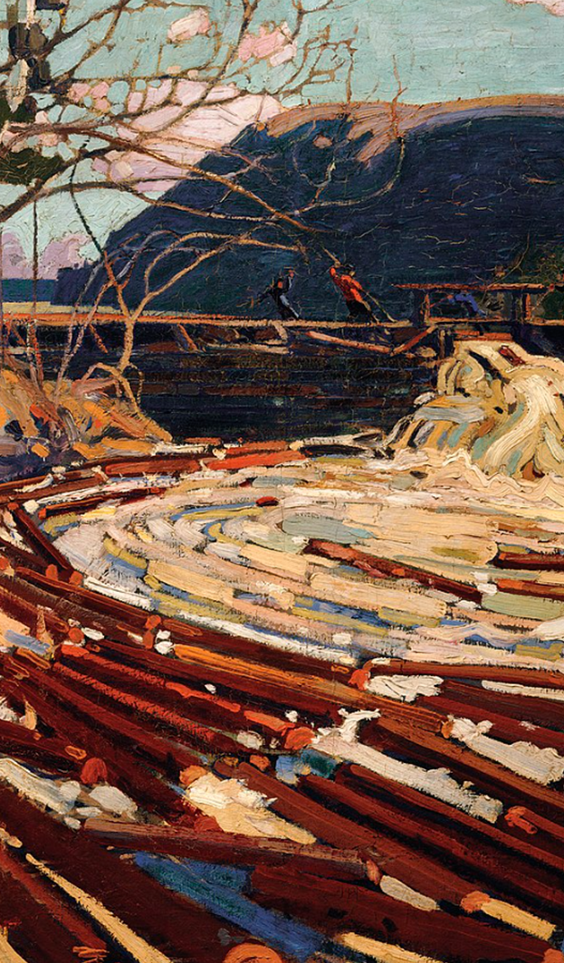
Overview
A Look in the Toolbox
From the Austrian Umweltzeichen
… to Green Events
Outlook 1. Submission
Life Cycle Analysis (… again cycles 😉)
(Thomson, 1916, PD)
(Escher, 1961)

Slide 3
Where Did we Stop Last Time?
🤔

Slide 4






















So … Some more Steps to setting the Playfield
Company XY

Slide 5

What’s Next?
 | Focus on …
 | Substance |  | Procedure
Voluntary
Mandatory
Carbon Neutral
Cradle to Cradle
Further CSR activites
Life Cycle Assessment
Österr. Umweltzeichen
B-Corp
ESG reporting: GRI, SASB, ISSB etc.
Climate-focused reporting: TCFD & CDP
Social-focused standards: SA8000
Sector-specific standards: OECD Due Diligence Minerals
XY
Environmental Management
Sustainability Management
EU CSRD
ISO 14001 EMAS
XY
EU Industrial Emissions Directive (IED)
✅
EU Corporate Sustainability Due Diligence Directive (CSDDD)
EU Emissions Trading System (ETS)
EU Green Claims Directive
Env. Impact Assessment (EIA)
Nat. regulations on air, waste, water & soil
✅
✅

Slide 6

So …
👉 give me more the tools!

Slide 7
The Austrian Umweltzeichen

Slide 8
What is the Umweltzeichen?
🤔

Slide 9

Digression: Eco-Labels
👉 Voluntary certifications product meets specific environmental standards across life cycle
3 types of eco-labels (cf. ISO 14020 series):
Type I (ISO 14024): Independent third-party verified
EU Ecolabel, Österreichisches Umweltzeichen
Type II (ISO 14021): Self-declared environmental claims
“recyclable”, “biodegradable”
Type III (ISO 14025): Based on quantified environmental data
Environmental Product Declarations – EPDs
Accurate
Substantiated (data)
Specific
Explained
👉 Life Cycle Analysis

Slide 10

The Austrian Umweltzeichen
Since 1990 (Austrian Ministry for Environment):
among the first national eco-labels in Europe
developed with independent experts (VKI), environmental organisations & industry
highlight environmentally friendly products & services 👉 (public) procurement
paper & cleaning agents
Managed by
Umweltzeichen office (BM Innovation, Mobilität & Infrastruktur)
Austrian Environment Agency (UBA)

Slide 11
The Austrian Umweltzeichen: Some Questions
What can be certified?
Who is involved?
How is the certification processes designed?

Slide 12
What can be Certified with the Umweltzeichen?
Traditionally: Products & services
Building materials & construction products
Cleaning appliances
Office, paper & printing
Gardens & parks
Green energy
Financial products
Mobility
Data centres
Shoes & clothing
Additionally: Services
Tourism businesses (hotels, hostels, campsites)
Travel offers and tour operators
Catering and gastronomy
Cleaning services
Green events and event locations
Cultural institutions

Slide 13
What can be Certified with the Umweltzeichen?
Additionally: Educational Institutions
Schools and kindergartens
Adult education centres
Universities and higher education institutions
Educational programmes

Slide 14
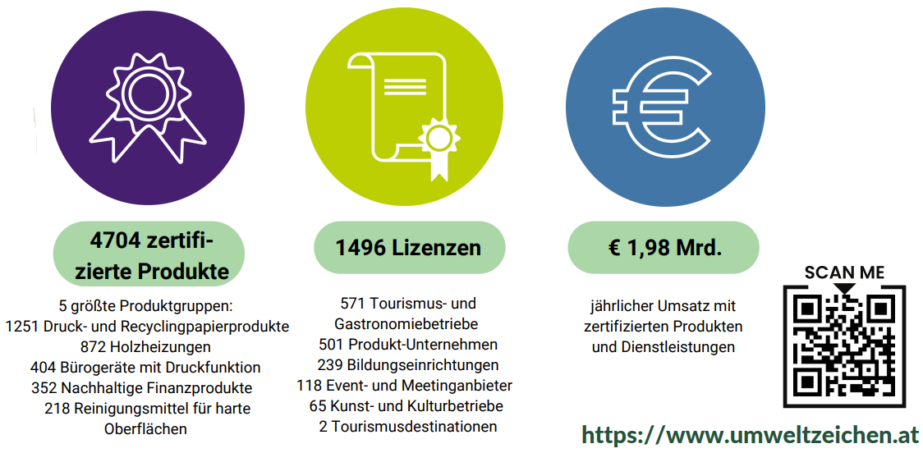
What can be Certified with the Umweltzeichen?
Notes:
2022 :Bundesinstitutionen umweltzeichenzertifizierten Strom
durchschnittlichen österreichischen Strommix über 146.000 Tonnen Treibhausgase pro Jahr

Slide 15
The Austrian Umweltzeichen: Some Questions
✅ What can be certified?
Who is involved?
How is the certification processes designed?

Slide 16
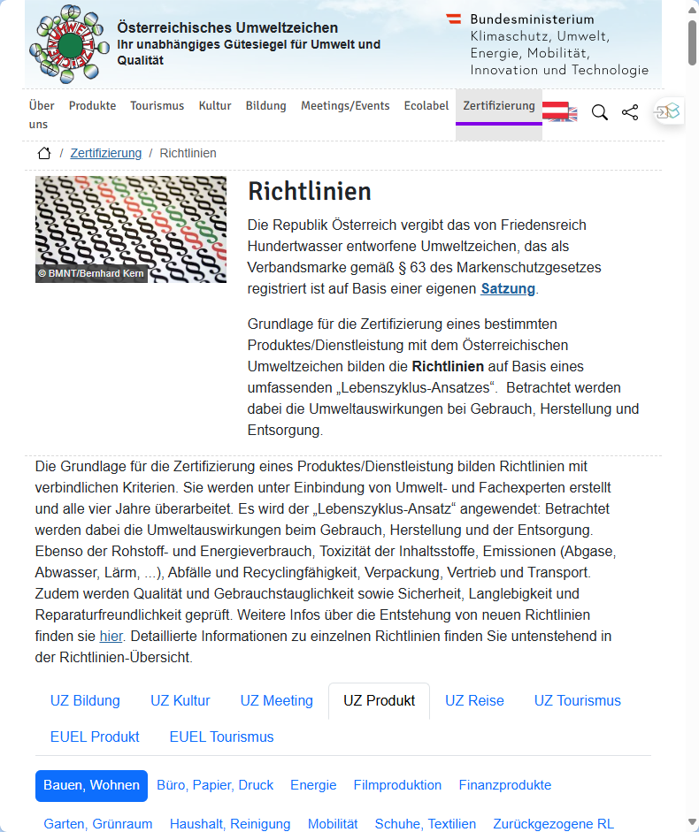
Who is Involved?
Product- resp. service owner
External auditors: differences between products, services & organisations 👉 detailed in “Richtlinien” (n: 66)
Consultants: Lizenznehmer*innen
VKI experts

Slide 17
The Austrian Umweltzeichen: Some Questions
✅ What can be certified?
✅ Who is involved?
How is the certification processes taking place?

Slide 18
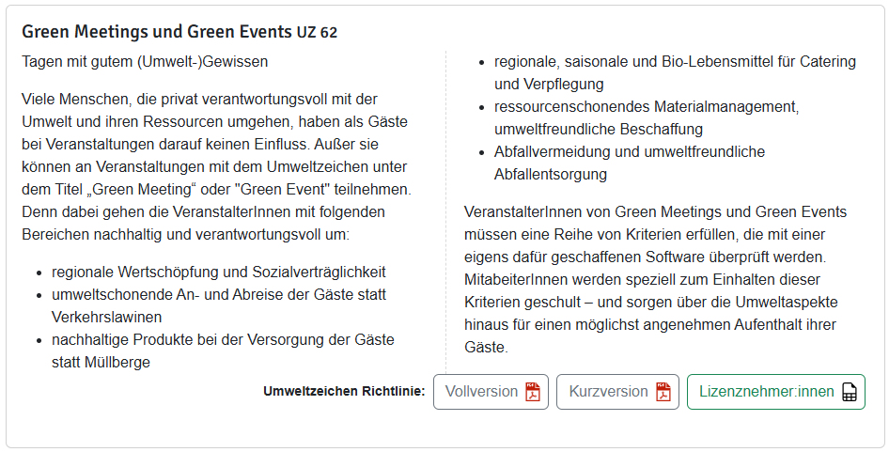
An Example: Green Meetings & Events (UZ 62)
Since 2006: Reduce environmental impacts of events
Promote climate-friendly travel options for participants
Minimise energy, water, and material consumption
Avoid & reduce waste through reuse & proper separation
Use regional, seasonal, and fair products
Ensure social responsibility
Raise awareness for environmental and social issues

Slide 19
The Austrian Umweltzeichen: Some Questions
✅ What can be certified?
✅ Who is involved?
How is the certification processes taking place?

Slide 20
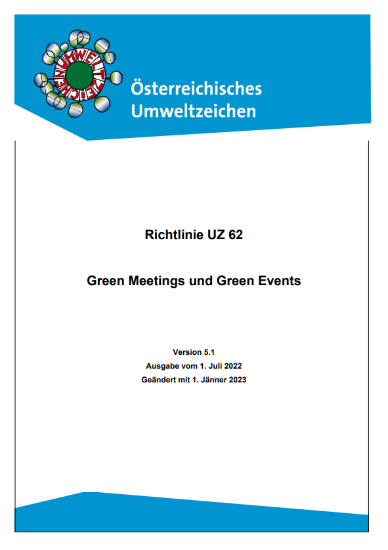
Green Meetings & Events (UZ 62): The Certification Process
Check event is eligible:
in Austria
cultural, sporting, scientific, corporate, or public events
single events or event series
Review criteria in Richtlinie UZ 62 – Green Meetings and Green Events
Event location and accommodation
Mobility and climate protection
Procurement, material and waste management
Catering
Social aspects
Communication and event management

Slide 21
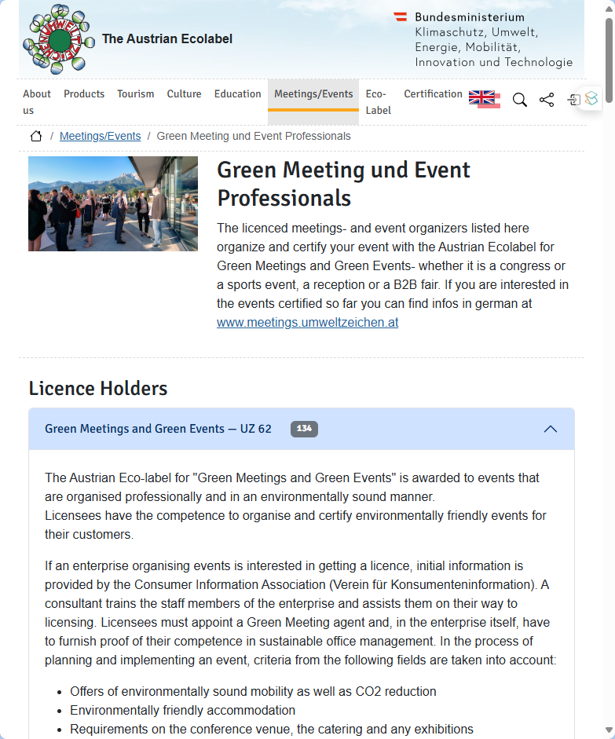
Green Meetings & Events (UZ 62): The Certification Process
Partner with a licensee: venue or agency
~ 130 organisations in AUT
Plan the event:
required & optional criteria from UZ 62
Collect documentation for all implemented measures
Register the event: online form at umweltzeichen.at
Submit documentation: at least 3 weeks before
Await evaluation and approval from the Ecolabel office
Event-marketing: Green Event logo

Slide 22
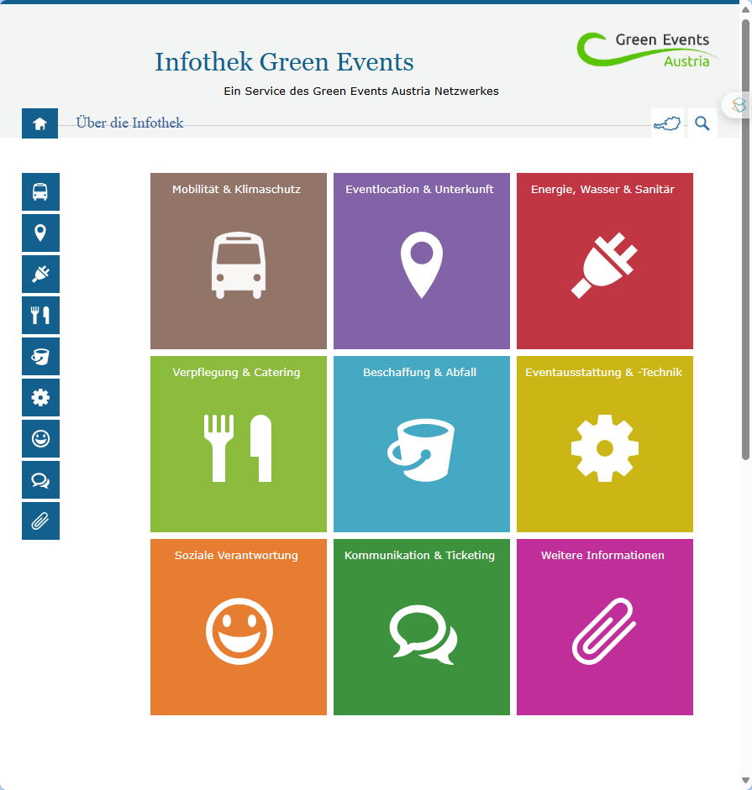
Some Interim Conclusions:
Quite elaborated & longstanding certification guidelines
👉 good documentation & networks of licencees
As with all Must-Option Systems:
Allocation of criteria often less demanding 👉 low entry level
Especially in semi-public procurement: legal requirement

Slide 23
Assessing Impacts at the Wachauer Volksfest

Slide 24
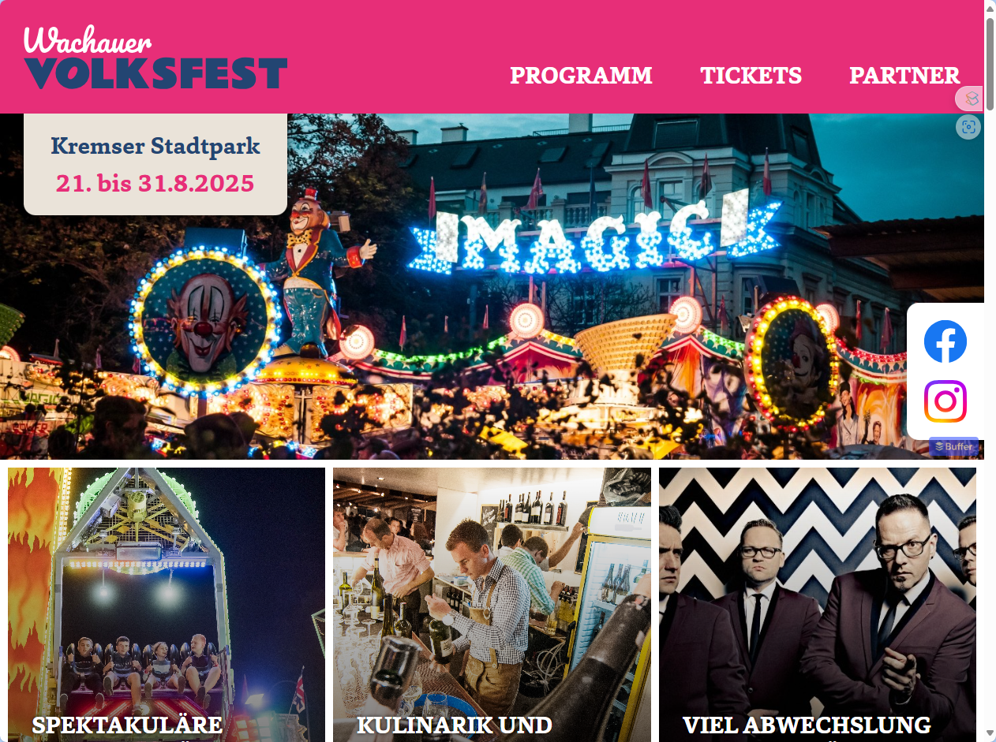
Our Example: The Wachauer Volksfest 2025

Slide 25
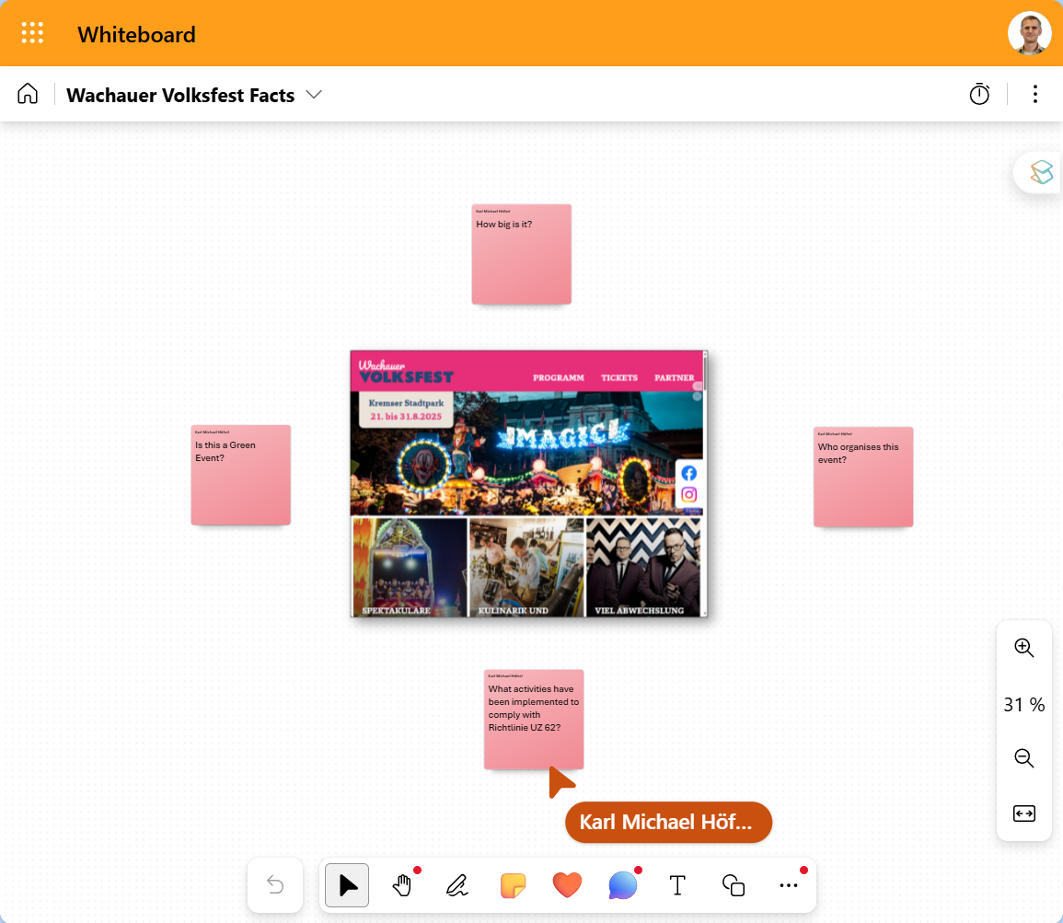
A qucik Factfinding Mission
https://imcfhkrems-my.sharepoint.com/:wb:/g/personal/karl_hoeferl_fh-krems_ac_at/EcU9-Ylt8t9FhYPShgV_I8UBt-DU9drF-DLILQAWNE3v3g?e=Wr1d2Y

Slide 26
A qucik Factfinding Mission
Some initial questions:
How big is it?
Who organises this event?

Slide 27
A qucik Factfinding Mission
Some initial questions:
How big is it?
Who organises this event?
Is this a Green Event?
What activities have been implemented to comply with Richtlinie UZ 62?

Slide 28
Your Written Report (40%): Assessing selected Impacts from the Green Event Wachauer Volksfest
Primary goal: Assessement & critical discussion of selected Green Event activities
Selected activity:
Replacing single-use cups & plates with reusable ones
Impact dimension:
All activities: CO2 emissions
Cups & plates:
fossil energy used
plastic waste produced

Slide 29
Your Written Report (40%): Assessing selected Impacts from the Green Event Wachauer Volksfest
First of all:
Form Groups of 2
👉 Teams: Group List

Slide 30
Your Written Report (40%): Assessing selected Impacts from the Green Event Wachauer Volksfest
Answer these questions in your reports, focusing on the intended switch from single to multiple use cups:
Impact 1: How much Crude Oil can be saved in the production process by switching?
Impact 2: How much CO2 can be saved overall by switching?

Slide 31
Your Written Report (40%): Assessing selected Impacts from the Green Event Wachauer Volksfest
Suggested report structure:
Report goals: cf. questions before
Description Wachauer Volksfest: Location, history, numbers
Incl. Green Event activities
Impact assessment of the switch from single to multiple use cups
fossil energy used: for V0 & V1 & difference
CO2 emissions produced: for V0 & V1 & difference
Critical discussion of the Green Event induced impacts
👉 Present:
Main assumptions
Calculation method
Main results (tables, graphs)

Slide 32
Your Written Report (40%): Assessing selected Impacts from the Green Event Wachauer Volksfest
Suggested report structure:
Report goals: cf. questions before
Description Wachauer Volksfest: Location, history, numbers
Incl. Green Event activities
Impact assessment of the switch from single to multiple use cups
fossil energy used: for V0 & V1 & difference
CO2 emissions produced: for V0 & V1 & difference
Critical discussion of the Green Event induced impacts
@ main results: Try to come up with easy-to-understand examples for the differences 👉 cf. “Results in Perspective”

Slide 33
Your Written Report (40%): Assessing selected Impacts from the Green Event Wachauer Volksfest
1 Report:
A4 PDF with Appendix A: Excel-Sheet with calculations in detail
Naming Report: Group_XY_Report.pdf
Naming Appendix: Group_XY_ Appendix.xlsx
Max. 10 Pages incl. Cover & literature
Upload in Teams 👉 Folder “Submission Wachauer Volksfest”
📅 Deadline: Fr. 06.06.25 / 12.00

Slide 34
Life Cycle Analysis

Slide 35
Life Cycle Analysis?
🤔

Slide 36
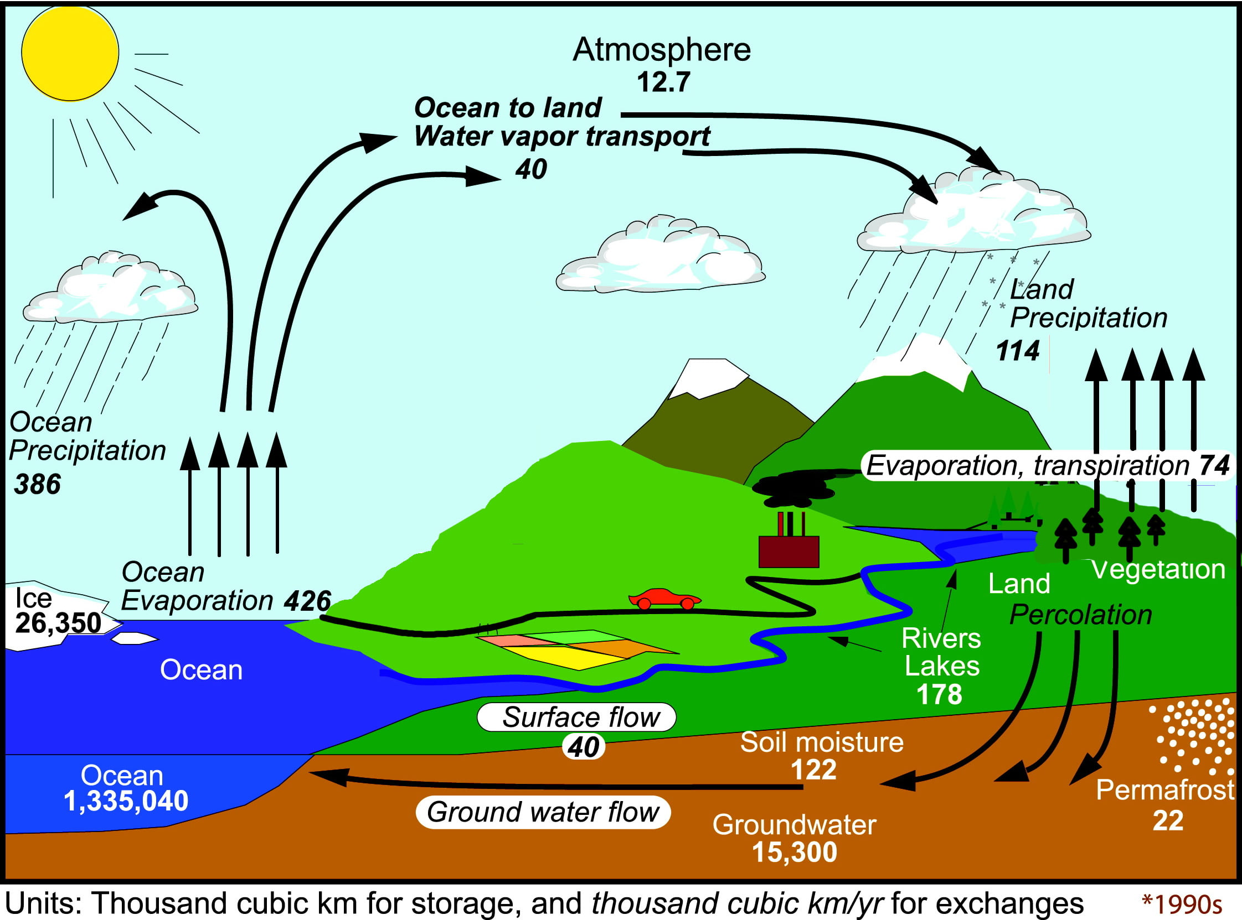
Natural Life Cycles

Slide 37
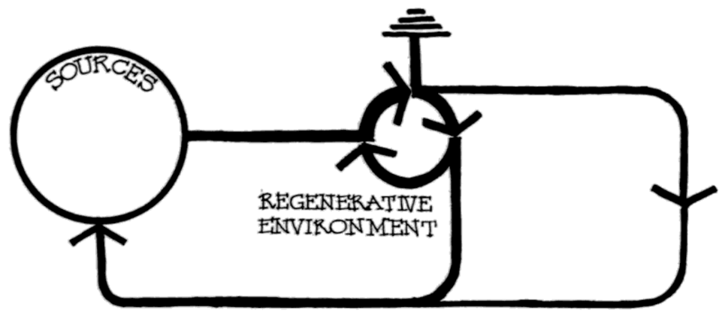
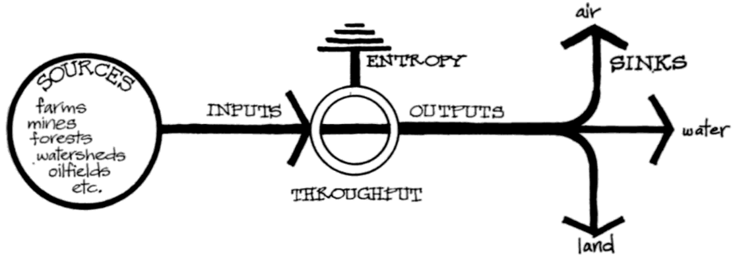
F) Regenerative Design ~1970+

Slide 38
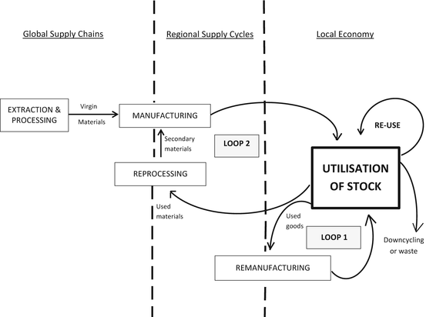
D) Performance Economy 1980+

Slide 39
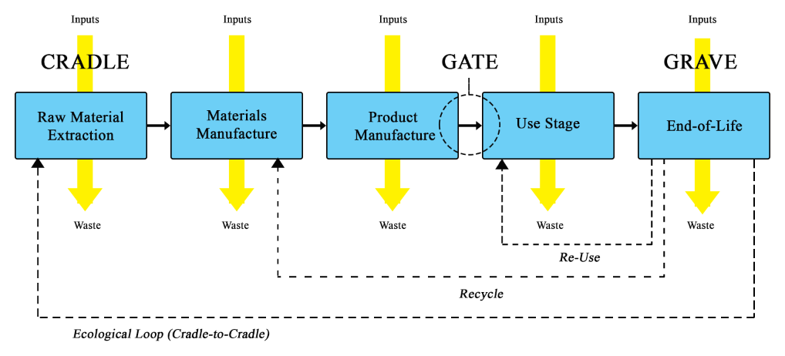
@ Life Cycle Assessment (LCA): Cradle 2 Grave

Slide 40
The Main Idea
Products & services:
need material & energetic input: Production, utilisation and recovery
Cause ouputs during production, utilisation and recovery 👉 impacts in different dimensions
Dimensions: toxiticity, CO2, ozon, freshwater, marine acidification, land occupation, noise etc.
If you can measure these in- & outputs: 👉 systematic comparison of products, services & policies
To do so: structure parts of life cycle & track performance

Slide 41
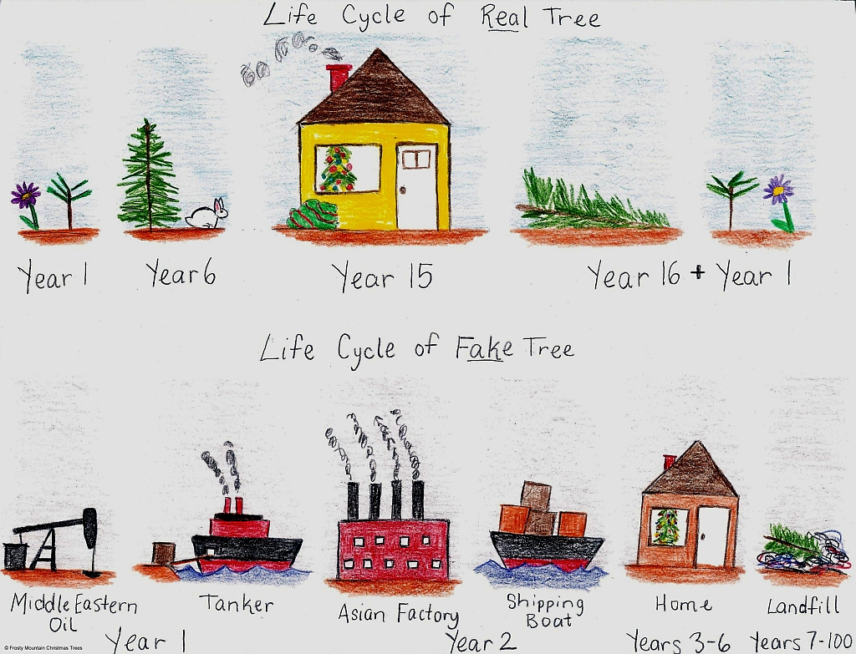
Some Examples

Slide 42
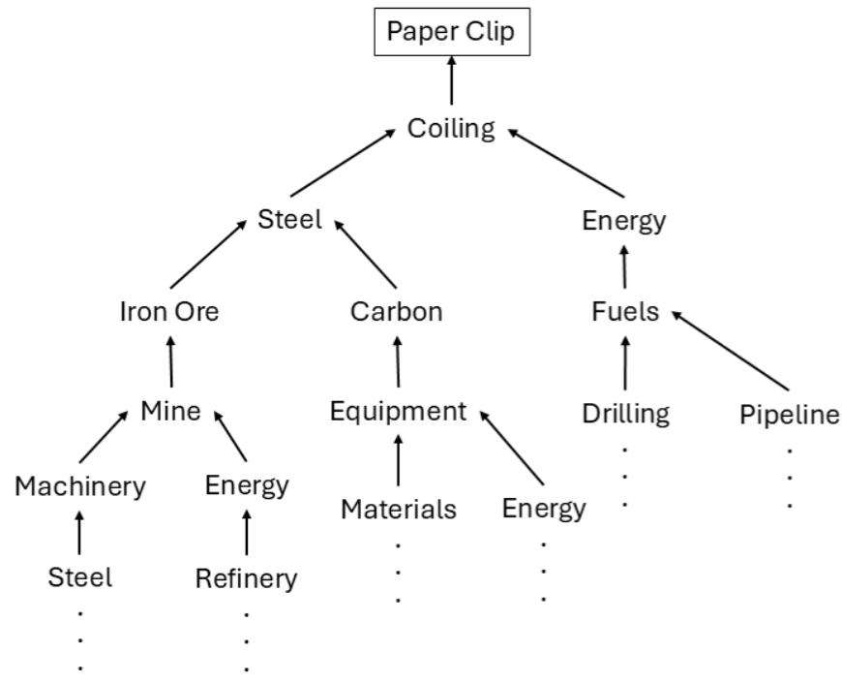
Some Examples

Slide 43
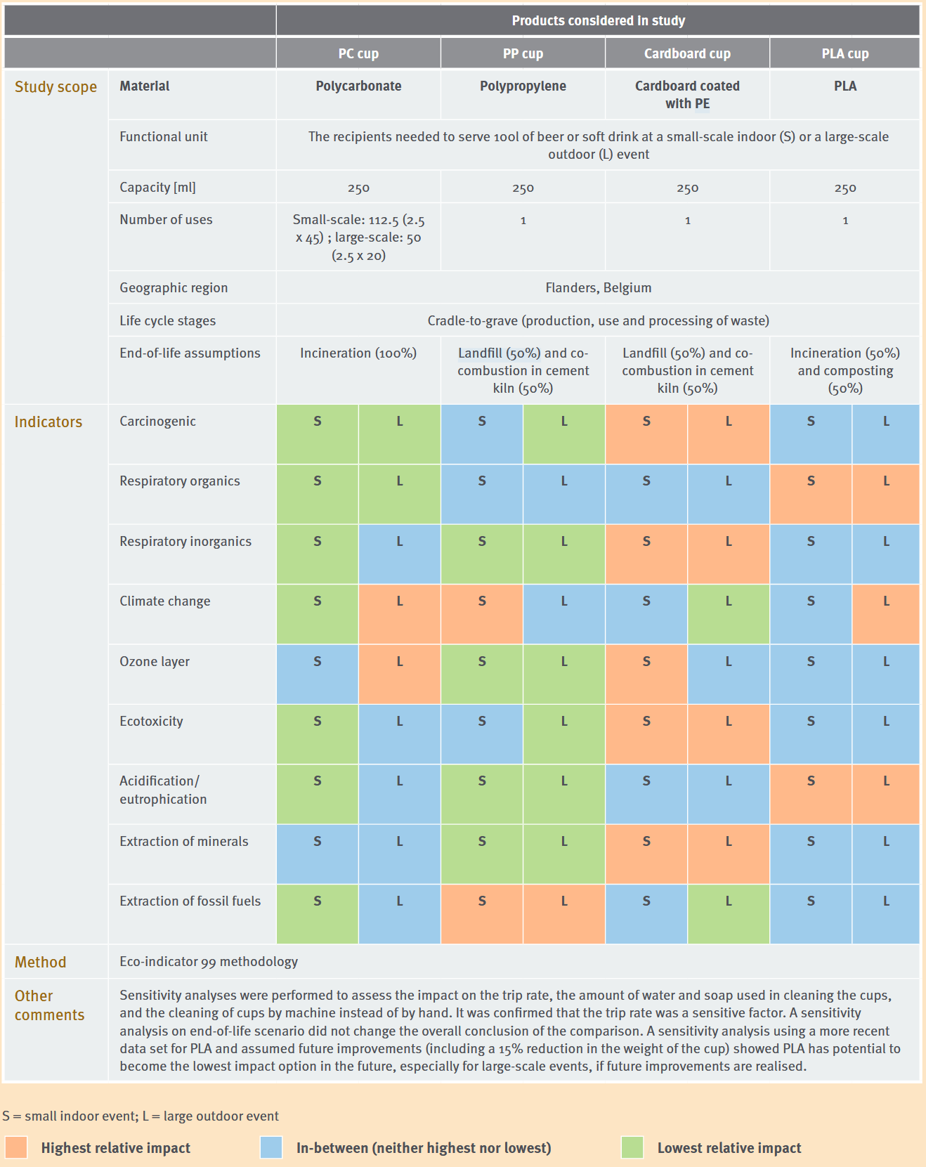

Some Examples

Slide 44
LCA – A New Thing?
1969 - first multi-criteria LCA study for Coca-Cola
Glass versus plastic for container
Choice between internal / external container production
End of life options (recycling or one-way)
Result: plastic bottle was best, contrary to expectations
Study never published
Questions of validity then occurred (a running theme!)
👉 Calls for a standardization process

Slide 45
Life Cycle Analysis (LCA): Cradle to …
life cycle of a product: from raw materials production and extends to manufacture, use, transport, and recovery
cradle2gate
cradle2grave

Slide 46
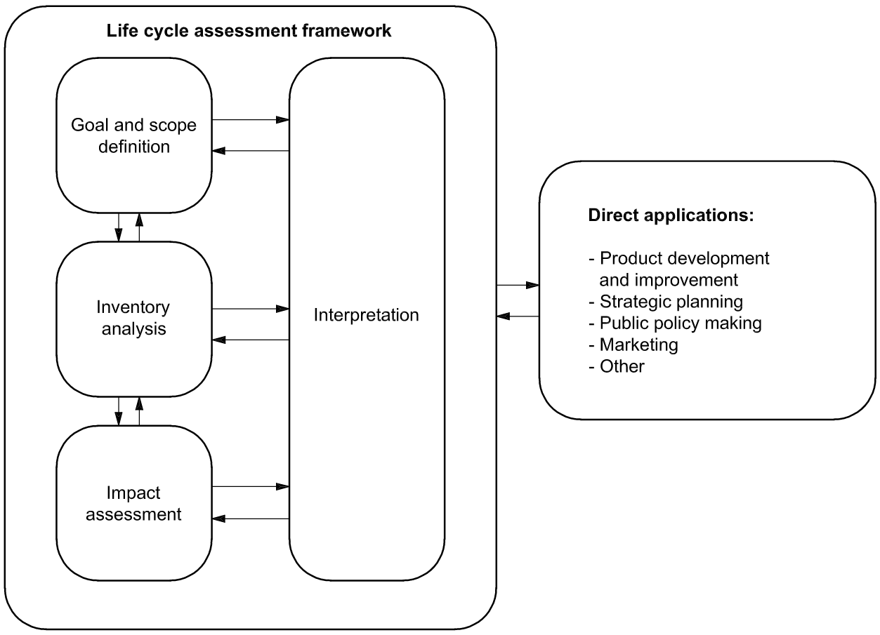
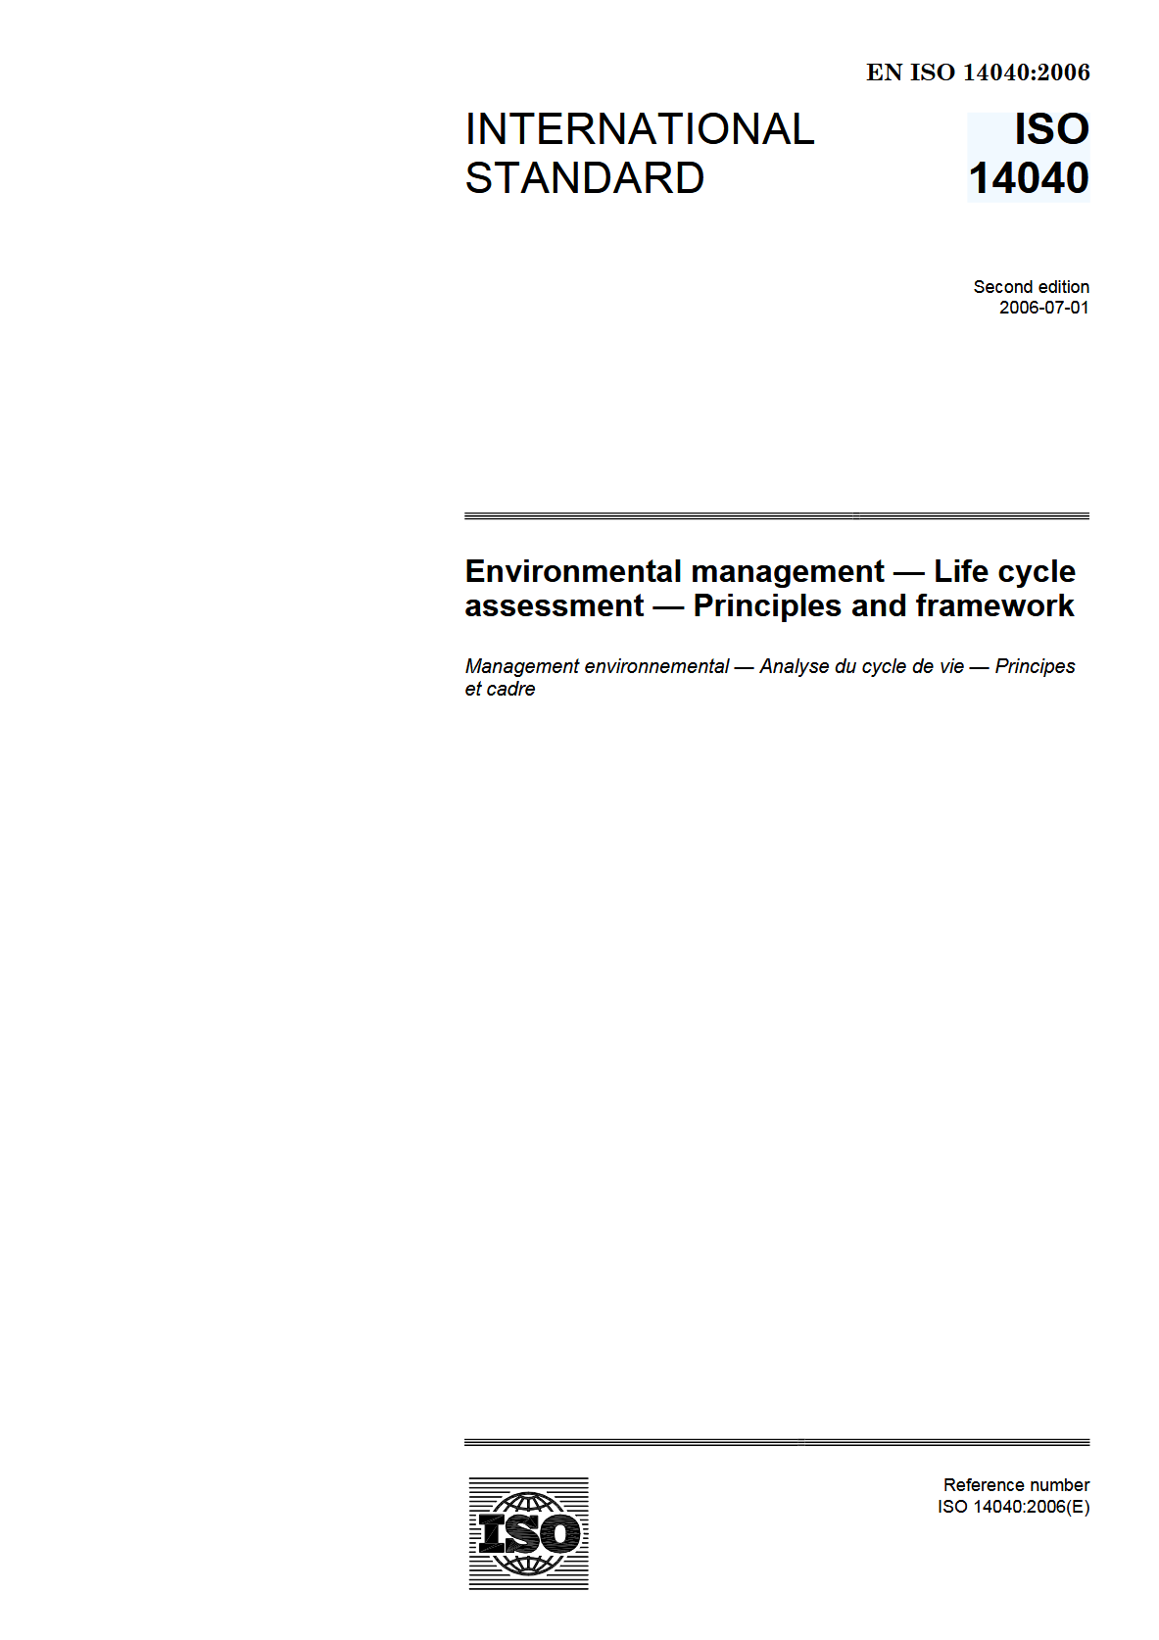
How 2 LCA

Slide 47
How 2 LCA

Slide 48
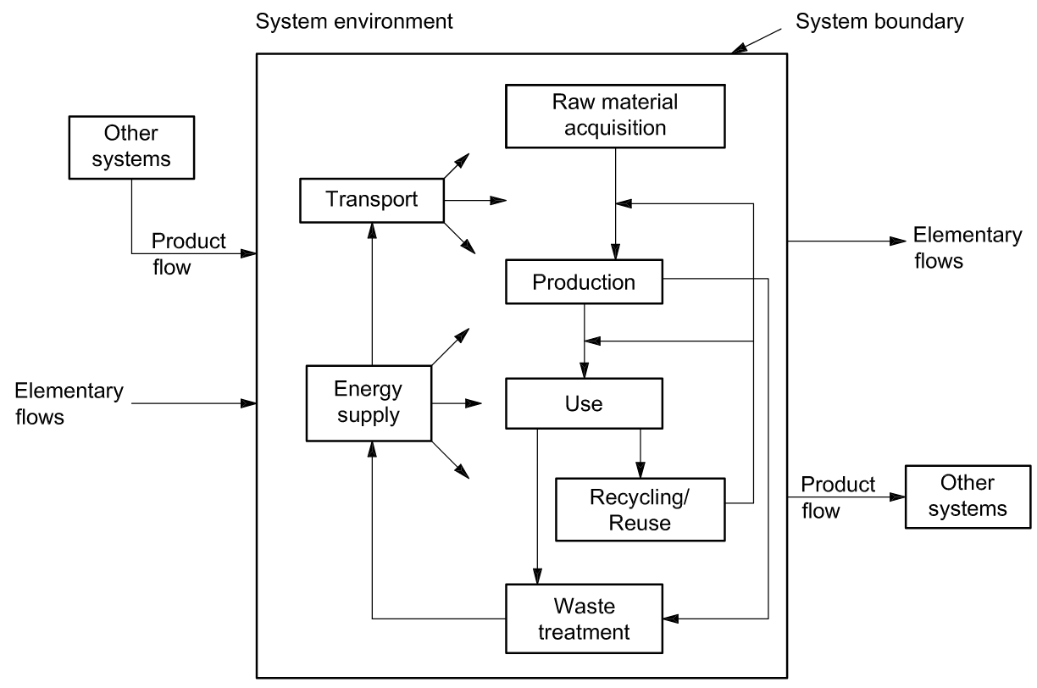
@ Goals & Scope
Define: Product system
system boundaries
Functional units: 👉 units to compare
Unit processes to assess

Slide 49
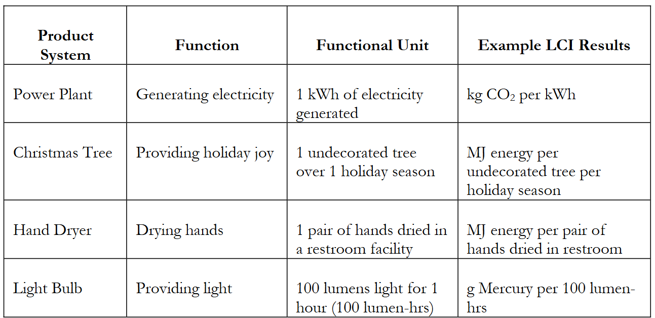
@ Goals & Scope
Define: Product system
System boundaries
Functional units: 👉 units to compare
Unit processes to assess

Slide 50
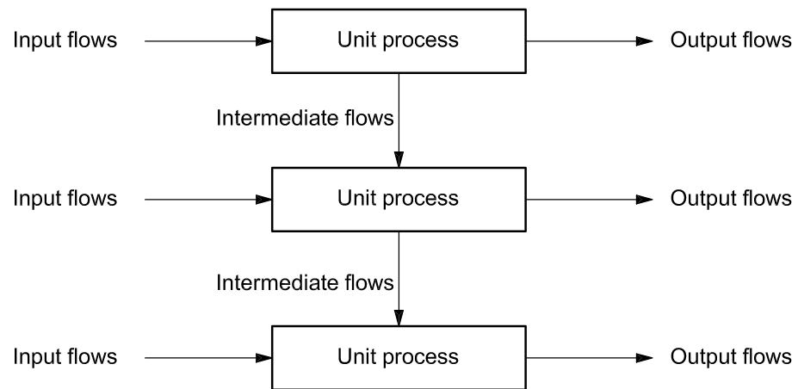
@ Goals & Scope
Define: Product system
System boundaries
Functional units: 👉 units to compare
Unit processes to assess

Slide 51
How 2 LCA: Inventory Analysis
Compile quantified inputs and outputs for every unit process
Gather data on energy, materials, water, emissions, waste and co-products, etc.
Map supply-chain flows and ensure system completeness

Slide 52
How 2 LCA: Impact Assessment
Convert inventory flows into environmental impact potentials with characterisation factors
E.g. t CO2-equivalents
In case of multi-criteria assessments: Organise results into midpoint categories
climate change, particulate matter, acidification, eutrophication, toxicity, resource depletion, water use
Normalise impacts to a reference population or region 👉 make magnitudes comparable
Apply weighting or ranking for a single composite score

Slide 53
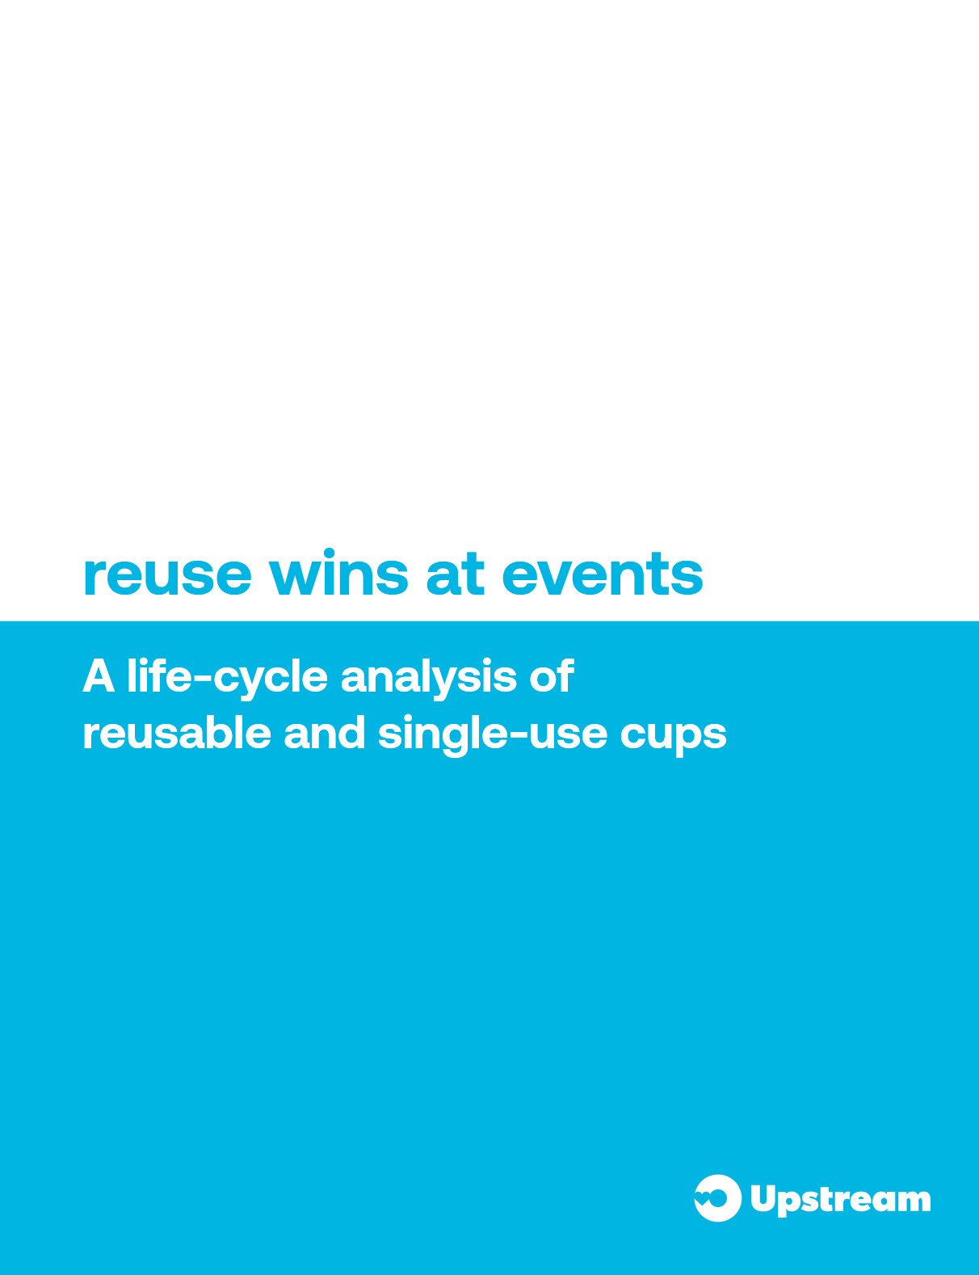
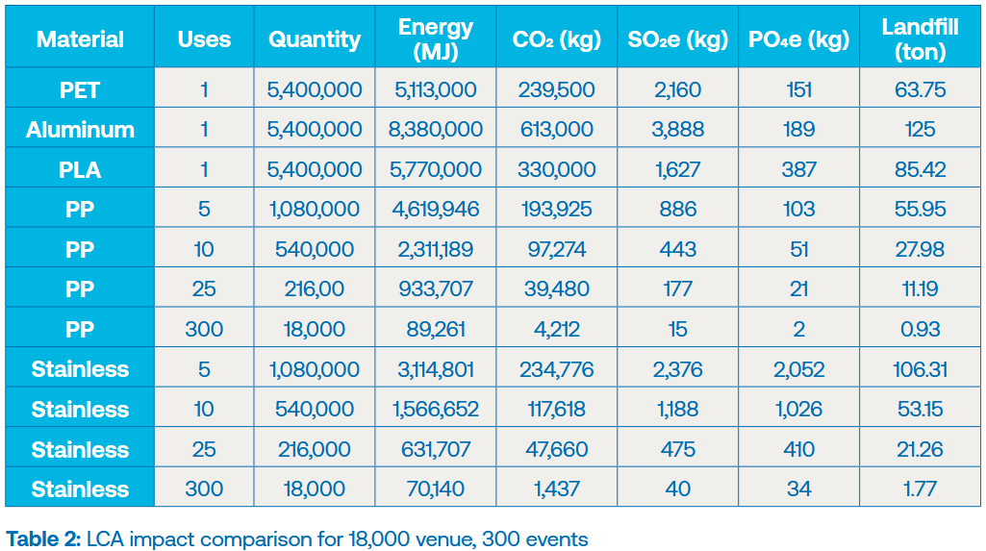
Again an Example: Impact Assessment for multiple criteria

Slide 54
Outlook

Slide 55
Wrap it up
Environmental Impact Assessment (EIA)
large-scale projects with significant environmental impacts 👉 precautionary principle
public participation, scoping, and multi-level licensing procedure
(Re-)Licensing Operational Facilities
Austrian Trade Regulation Act 👉 public interest: health, safety, environment, zoning
application, hearings, formal decision (“Bescheid”)
Waste Management & Waste Management Concept (WMC)
process descriptions, waste streams, logistics, and planning

Slide 56
Till next Session:

Slide 57
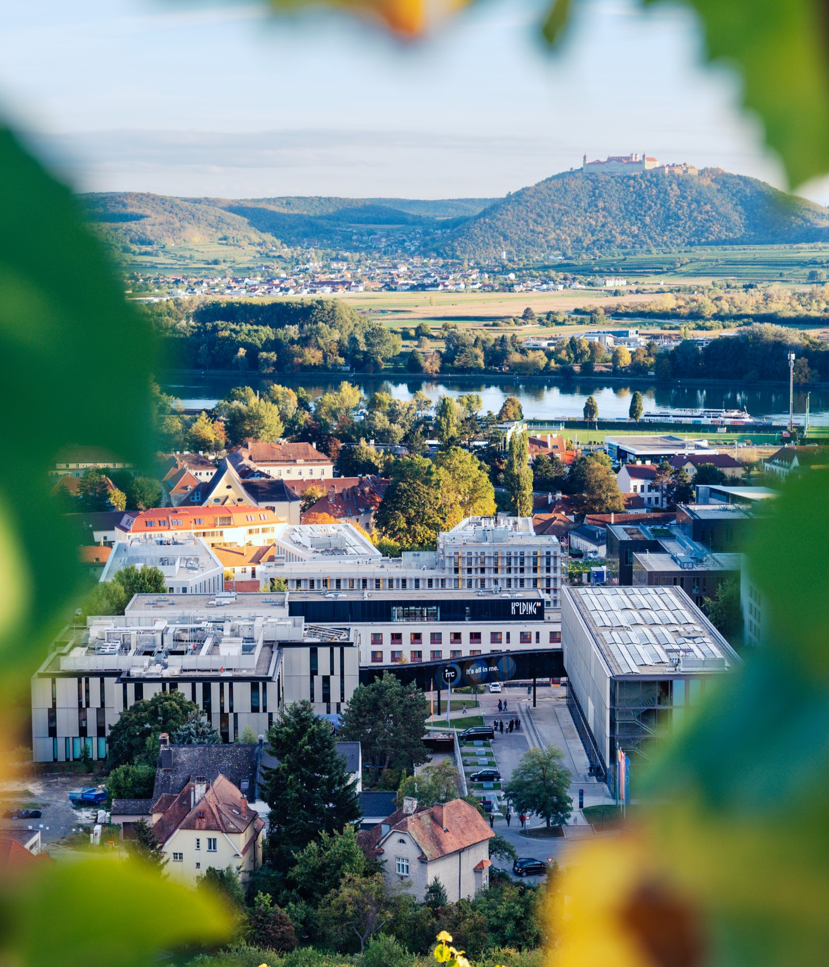

So long & cheerio!

